Slide 1
Rockbuster Stealth Data Analysis Project
Snigdha Sharma
Dec 2022

Slide 2
Table of contents
01
04
Overview
Recommendations
02
05
Statistics
Tableau Link
03
06
Insights
Questions

Slide 3
Overview
01
Rockbuster Stealth LLC is a movie rental company that used to have stores around the world. Facing stiff competition from streaming services such as Netflix and Amazon Prime, the Rockbuster Stealth management team is planning to use its existing movie licenses to launch an online video rental service in order to stay competitive.

Slide 4
02
Statistics
What do the numbers say?

Slide 5
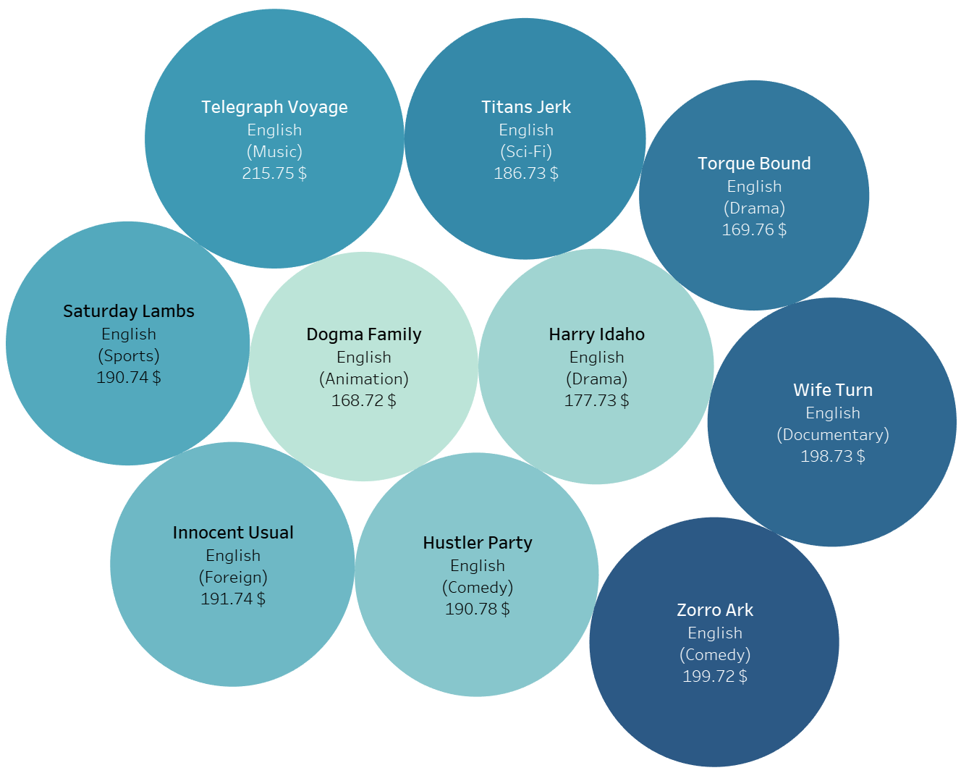
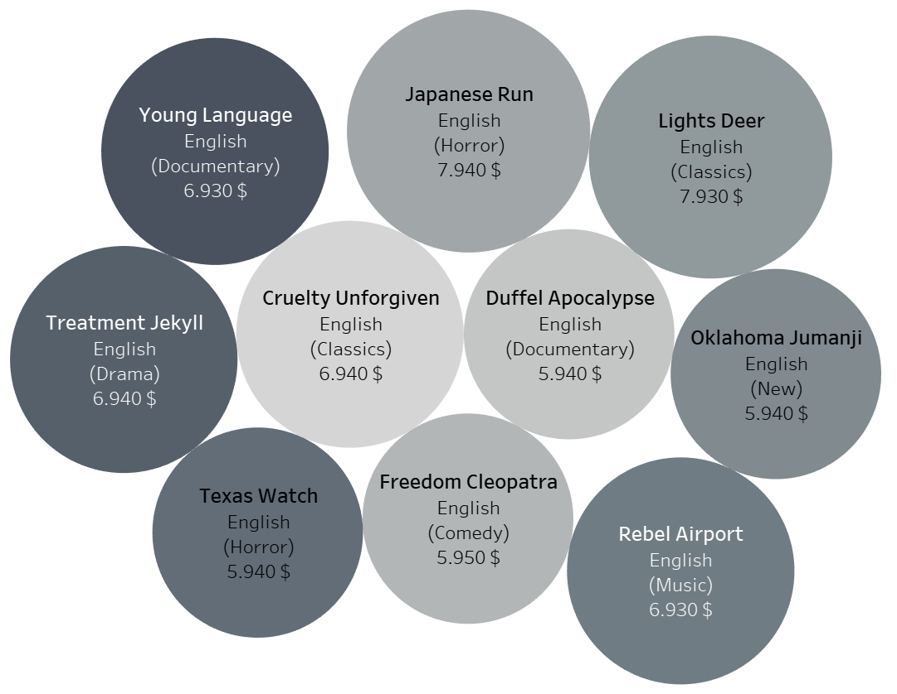
Bottom 10 Films by Revenue
Top 10 Films by Revenue
Total revenue generated by Rockbuster: 61312 $

Slide 6
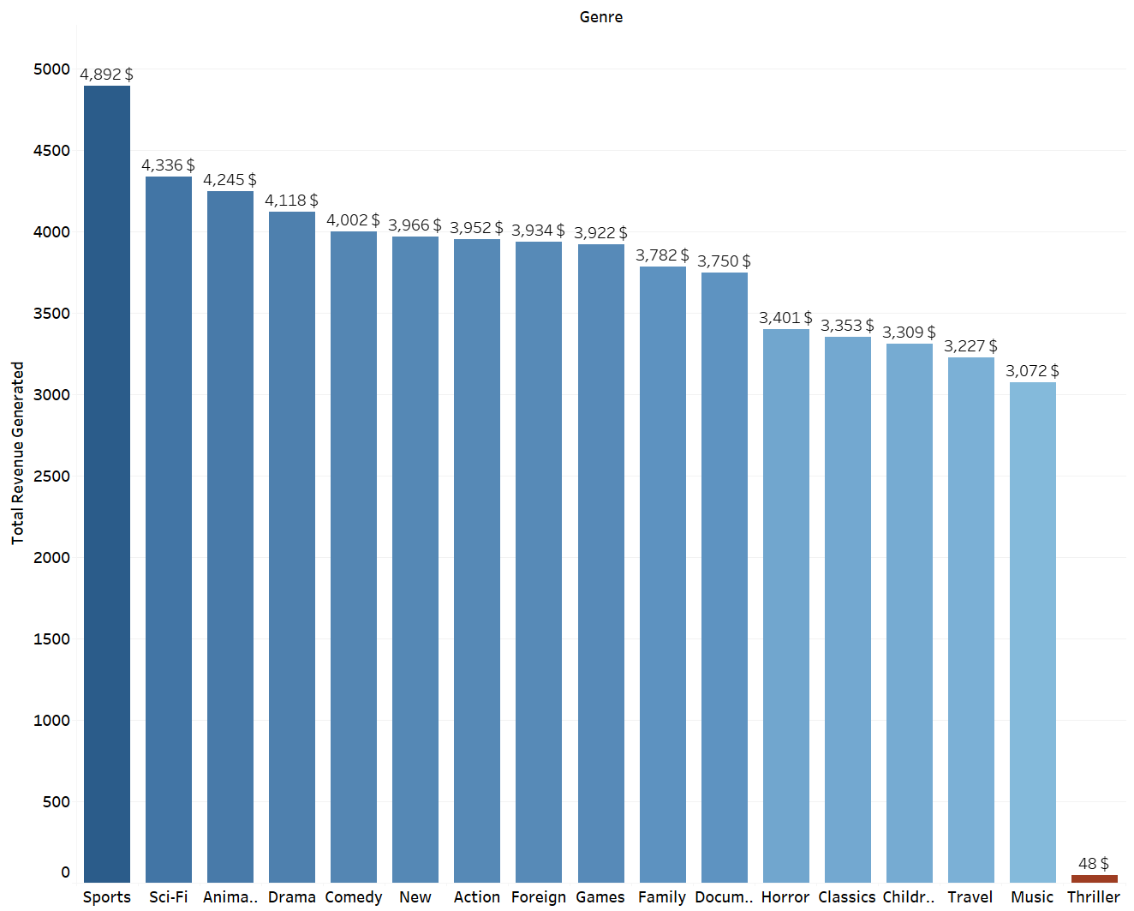
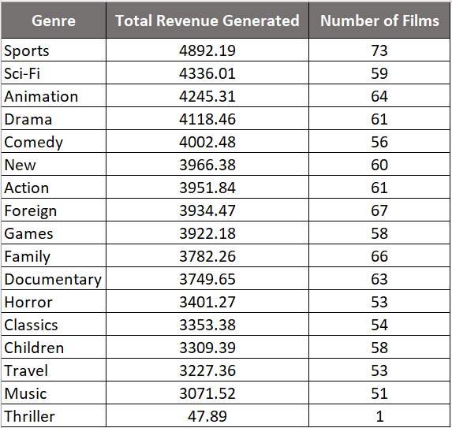
Top Genres by Revenue
Sports, Sci-Fi and Animation are the highest revenue generating film genres for Rockbuster

Slide 7
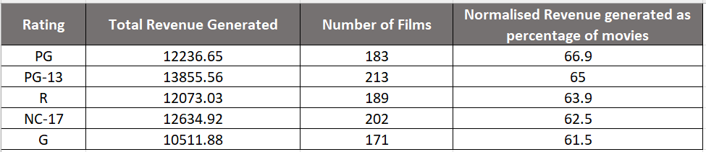
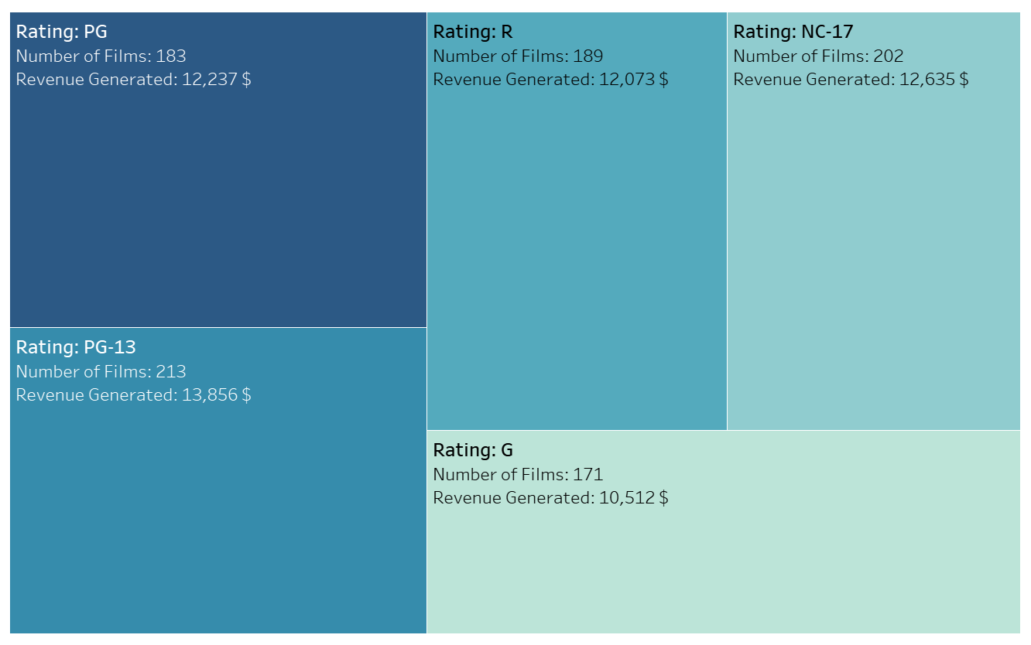
Rental Revenue by Rating
The maximum revenue is generated by PG rated films followed by PG-13

Slide 8

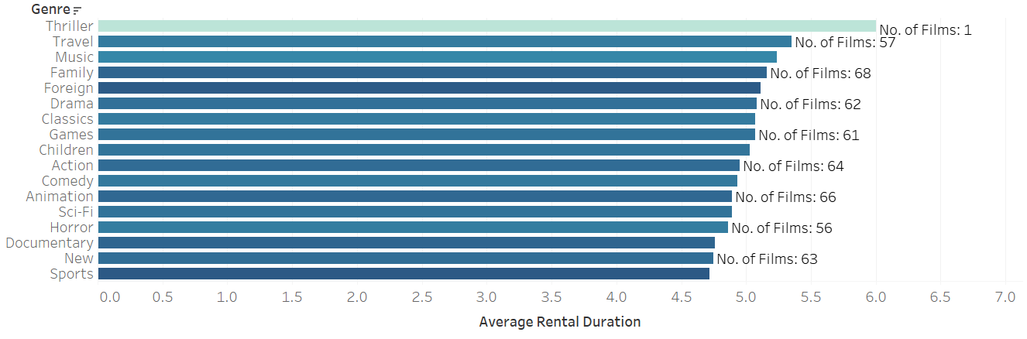
Rental Duration of All Films
Average Rental Duration by Genre
Thriller, Travel and Music films were rented for the longest duration

Slide 9
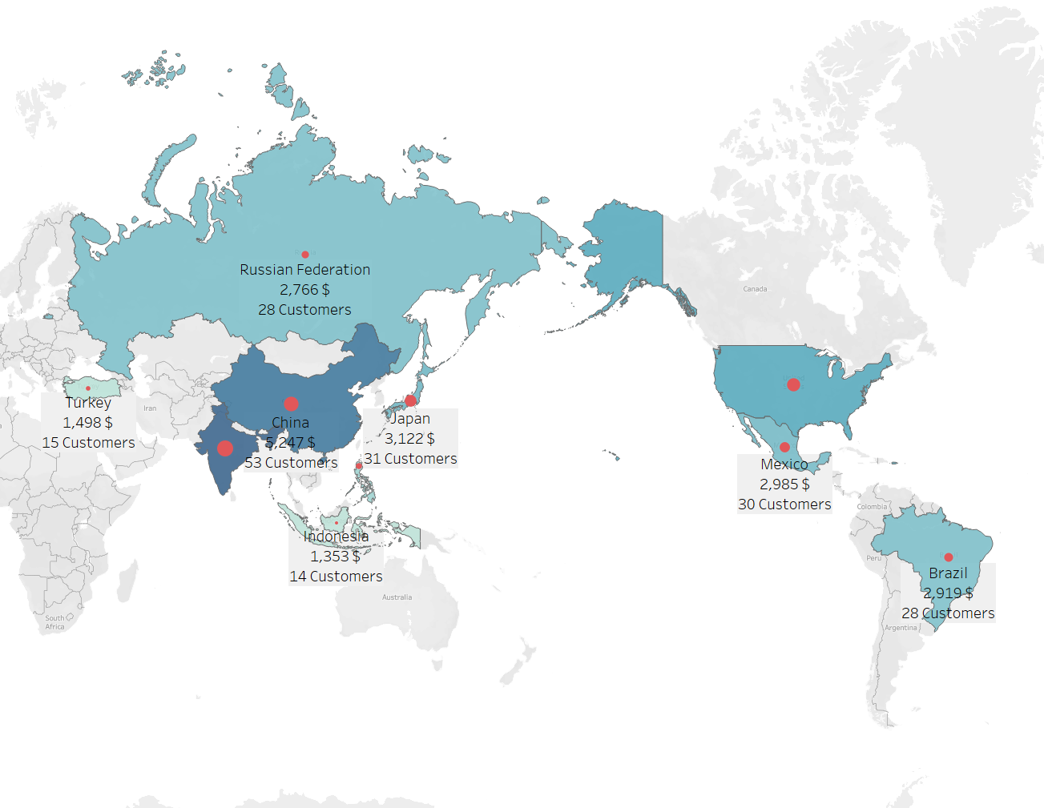
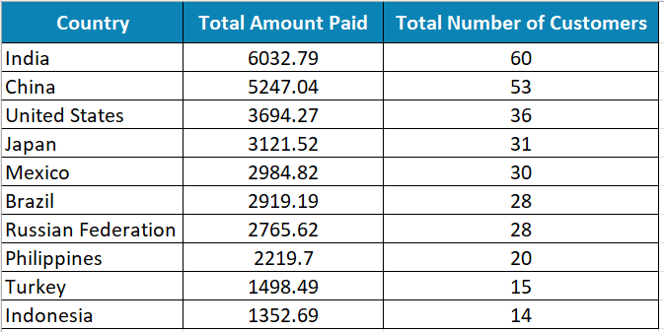
Top 10 Countries by Customer Count & Rental Revenue
Total Number of Rockbuster Customers: 599

Slide 10
Customers with highest lifetime value
Karl Seal
Cape Coral, USA
Marion Snyder
Santa Bárbara dOeste, Brazil
Ana Bradley
Memphis, USA
Marcia Dean
Tanza, Philippines
Mike Way
Valparai, India

Slide 11
03
Insights
What conclusions can be drawn from the data analysis?

Slide 12
India, China and the USA contain almost 25% of all Rockbuster customers and have together generated 25% of the total revenue.
Sports, Sci-fi and Animation genre films have been rented the maximum.
PG and PG-13 rated films are most popular rentals.
English language films such as Telegraph Voyage, Zorro Arcand Wife Turn are most rented
Thriller, Travel and Music films were rented for the longest duration

Slide 13
04
Recommendations
1. India, China and the USA should be the market of focus as Rockbuster’s customer base is already strong in these countries
2. The database should have more copies of Sports, Sci-fi and Animation films in English language as they are popular and generate maximum revenue
3. Thrillers have the maximum rental duration but there are not many films to draw a strong conclusion
4. Since PG and PG-13 films are generating large revenue the inventory should have movies that are rated such
5. To promote loyalty among users a credit point-based system should be developed, and the top 5 customers can get 100 extra points at the launch of the application
6. The marketing team should track the customer lifetime and send them relevant emails suggesting movies that match their profile, to increase engagement.

Slide 14
Tableau Link
05
Task 3.10 Final Project

Slide 15
Questions
06
Snigdha.priya29@gmail.com
+1 (650) 542-1432

Slide 16
Thanks!
Made with Slidesgo

